Slide 1


Slide 2
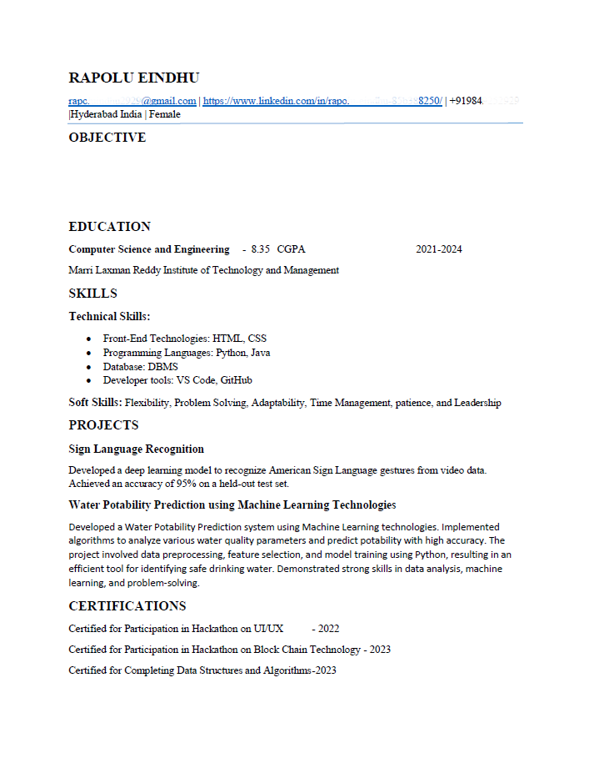
Sample Resume

Slide 3
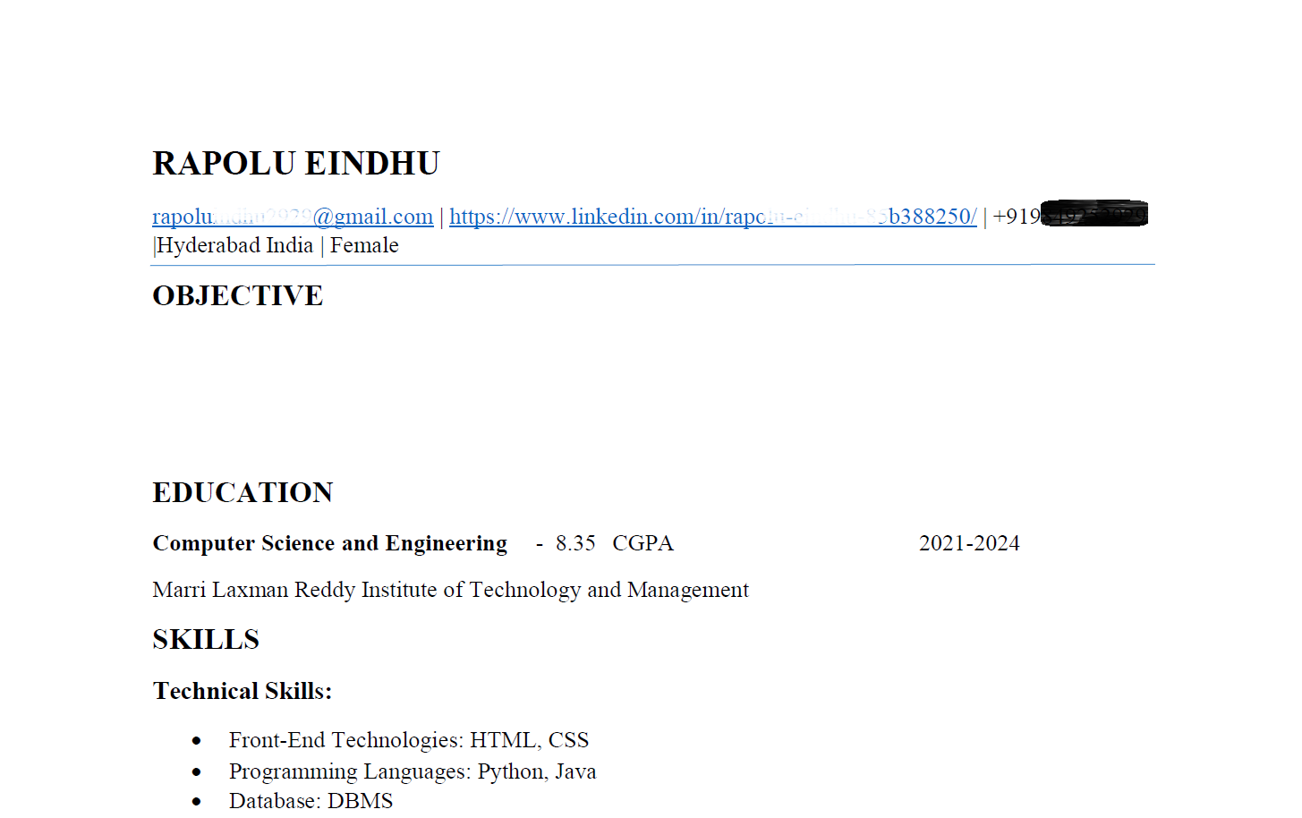
Alignment

Slide 4
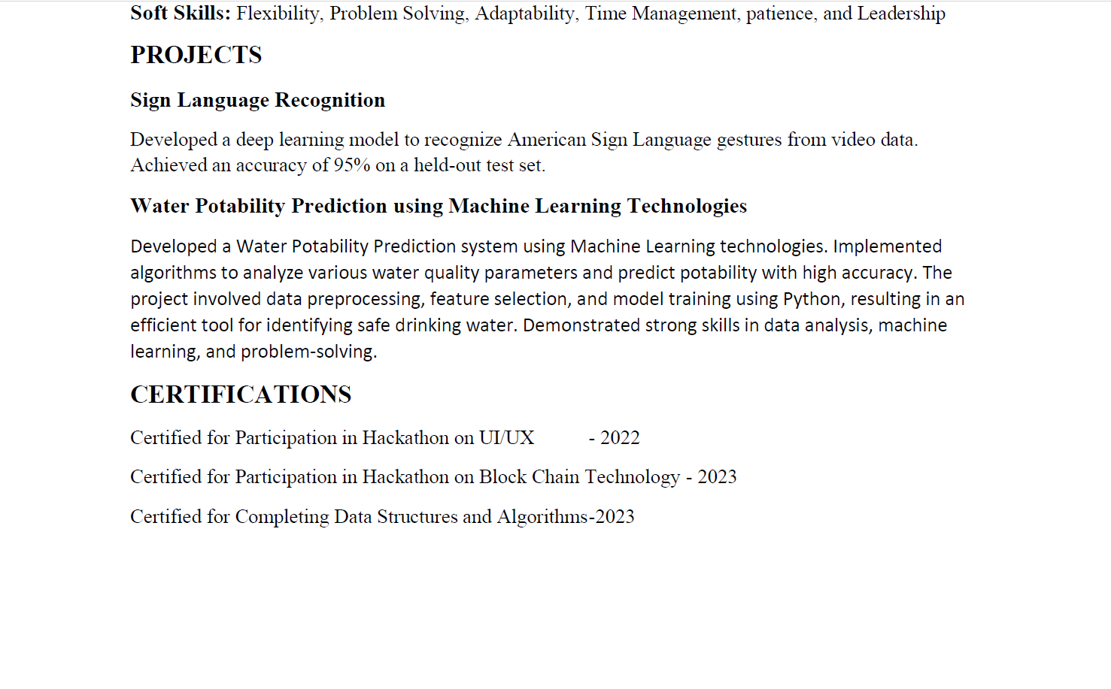
Line Spacing

Slide 5
Font Styles

Slide 6
Don't Mention Gender Specifications

Slide 7
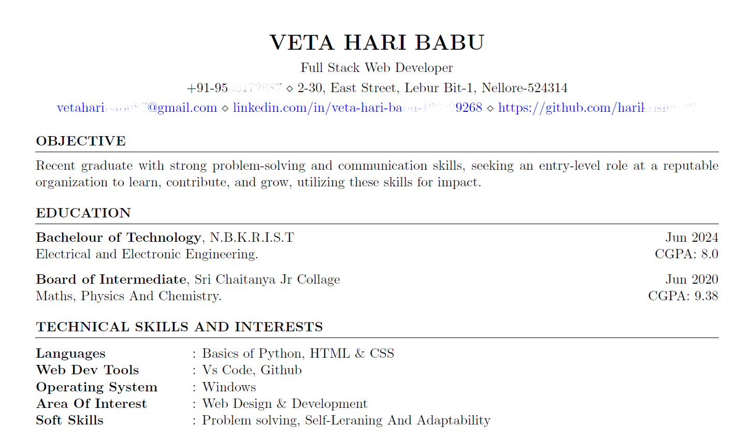
No Job Titles for Freshers

Slide 8
Carrier Objective OR Summary Should Be ATS Friendly

Slide 9
ATS Friendly Summary OR Carrier Objective
Generate Summary using ChatGPT
Match your Summary with given Job Description
Add Key words

Slide 10
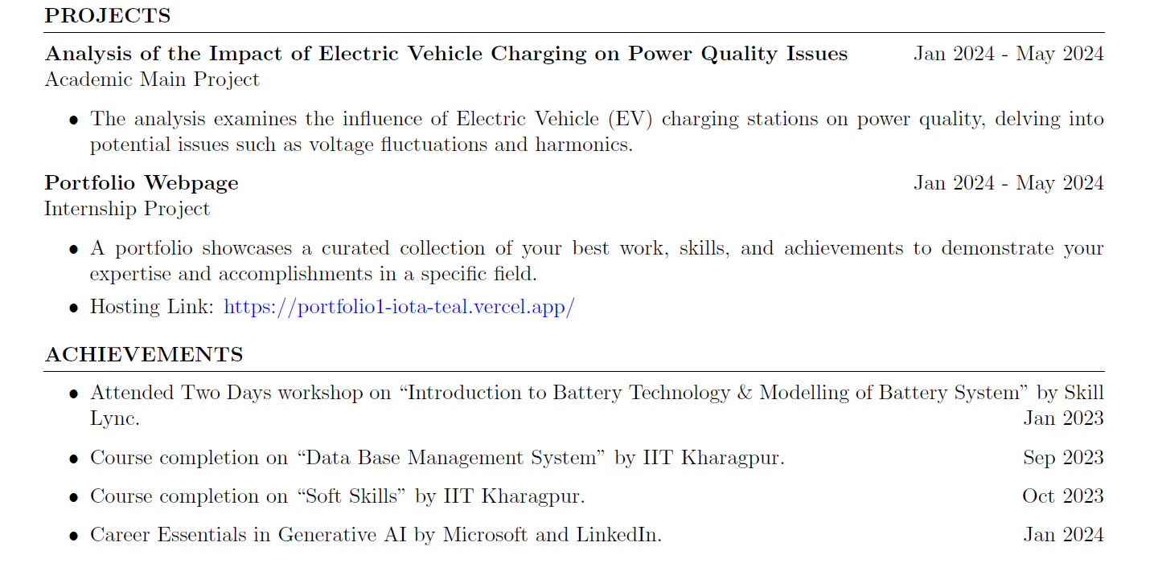
Bullet Points Spacing

Slide 11
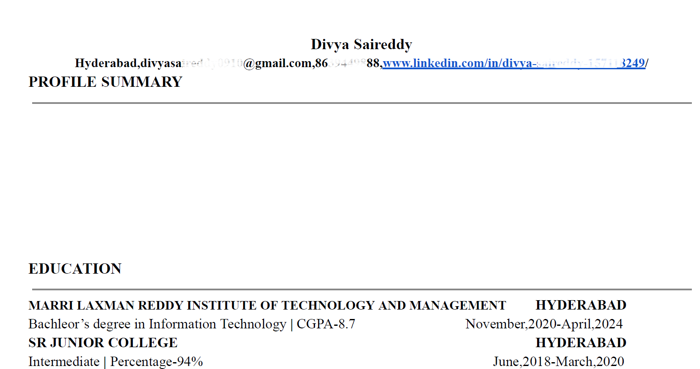
Full Name in Capital Letters Only

Slide 12
Alignment Spacing

Slide 13
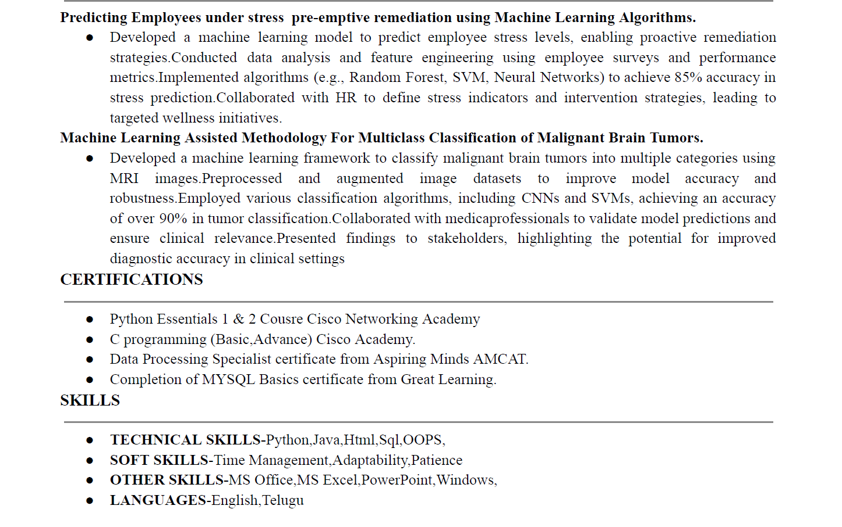
Word to Word Spacing:

Slide 14
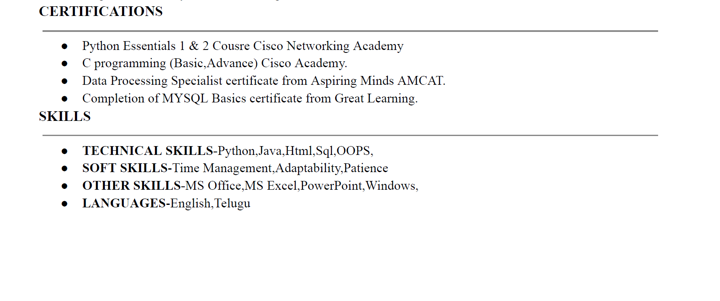
Alignment and Spacing in Skills:

Slide 15
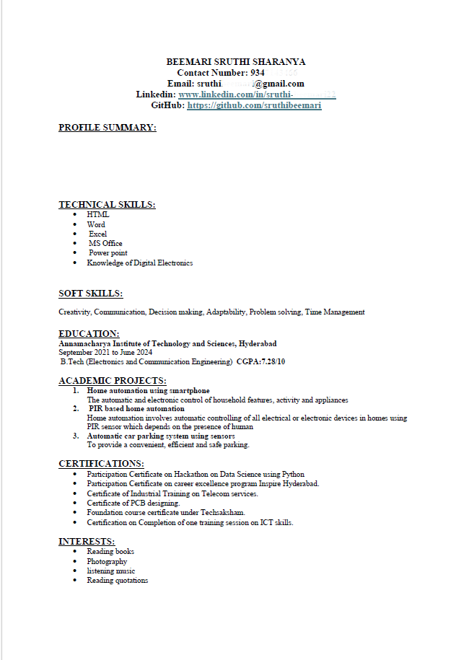
Page & Paragraph Spacing

Slide 16
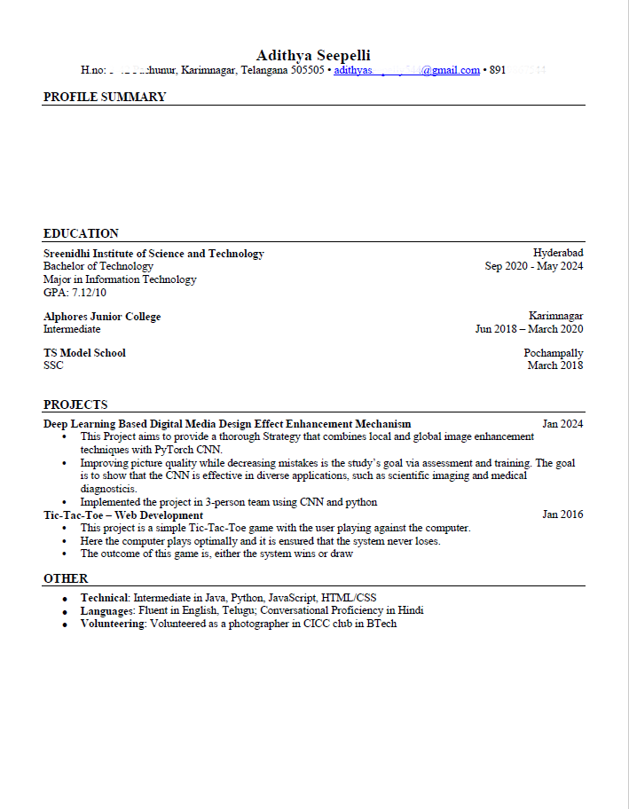
Page & Paragraph Spacing

Slide 17
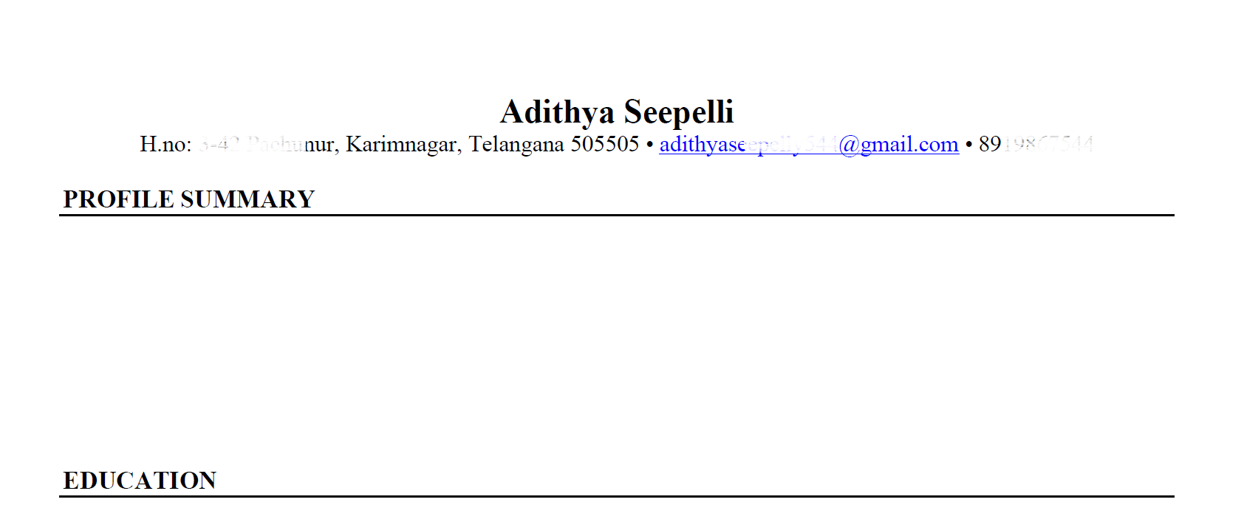
Missing Links
?

Slide 18
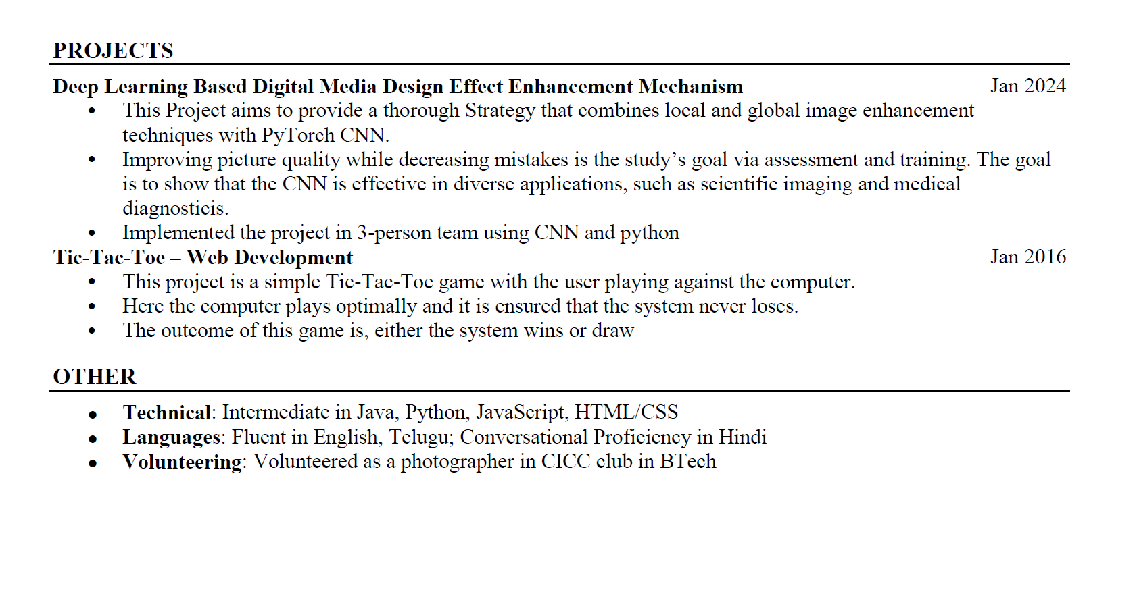
Identify the Mistakes

Slide 19
Mistakes Identified

Slide 20
Titles for Skills

Slide 21
Titles:
Technical Skills
Soft Skills
Java, Python, JavaScript, HTML/CSS
Communication skills, Team work, Problem solving, Time management, Decision making, Leadership, Critical thinking

Slide 22
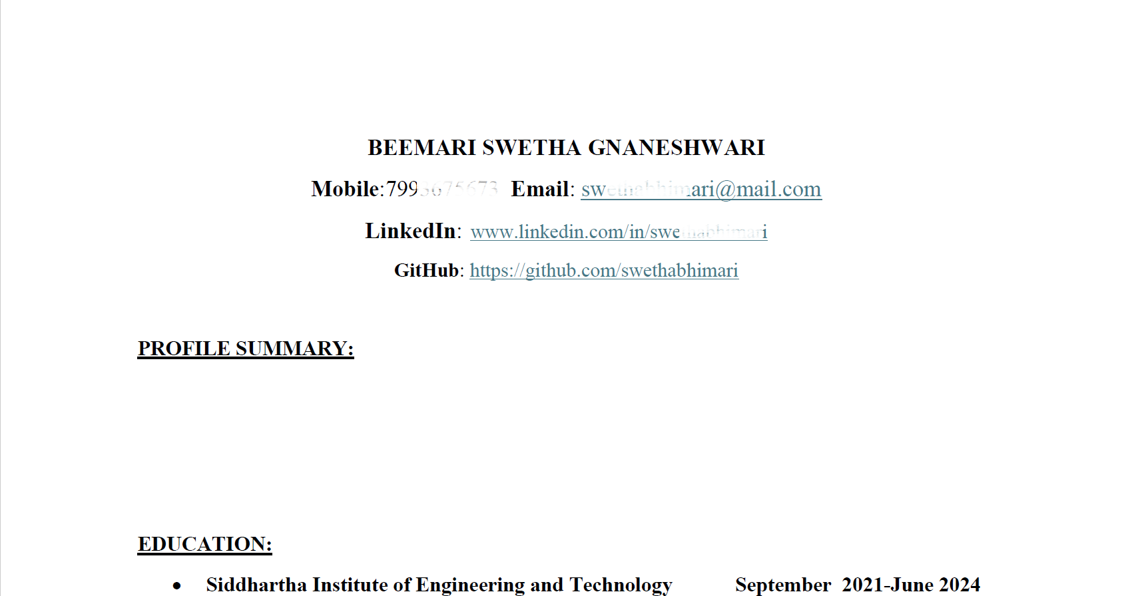
Over Spacing in Headings

Slide 23
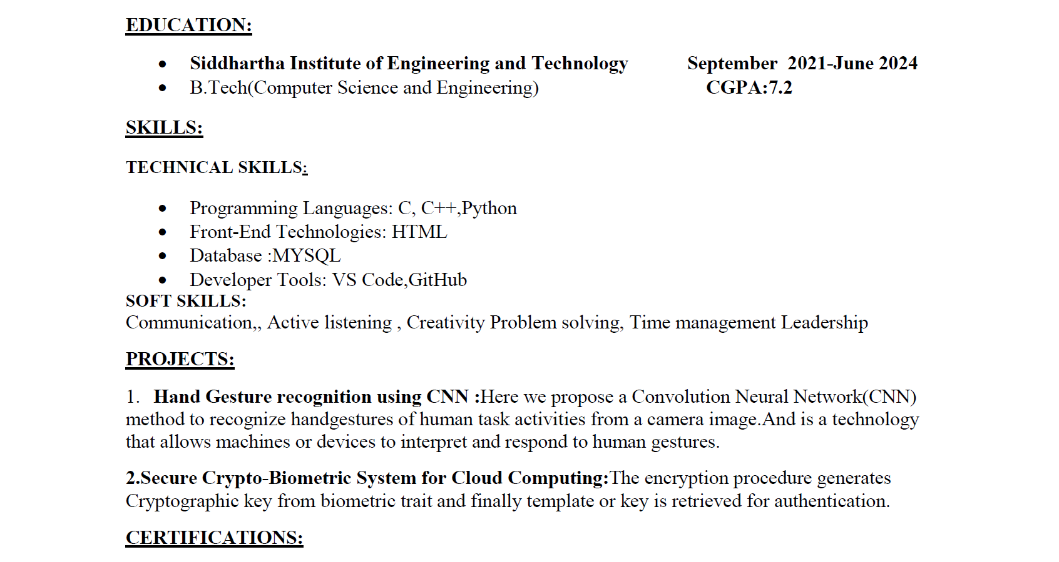
Alignment Corrections

Slide 24
Side Heading Corrections

Slide 25
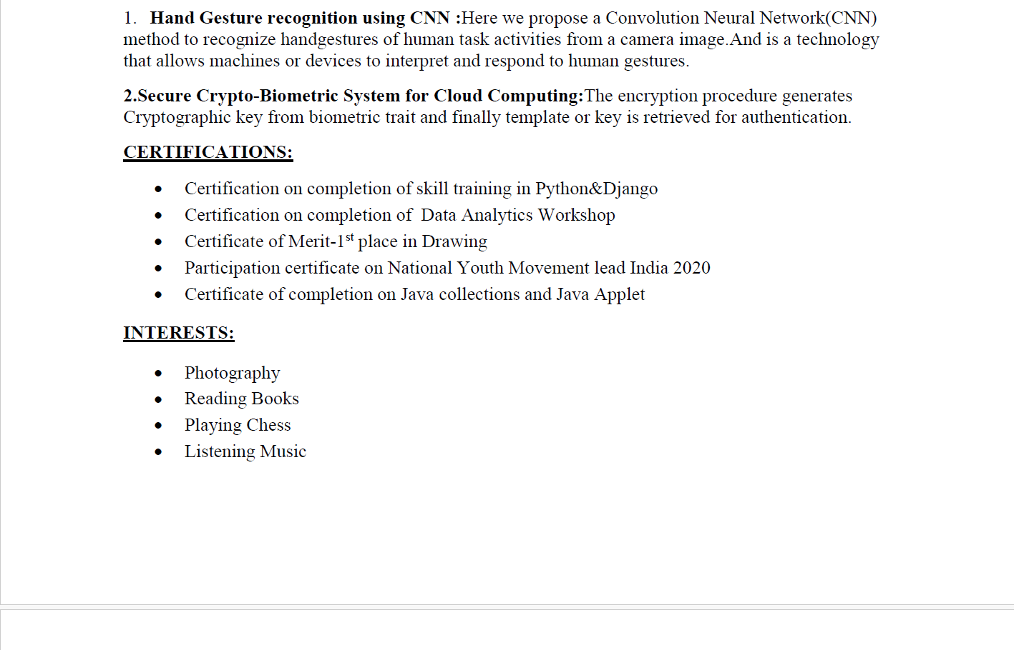
Hobbies Or Options
This is an Option to Mention in your Resume
At times HR may Ask few points about your hobbies
So there should be a proper explanation of your hobbies.

Slide 26
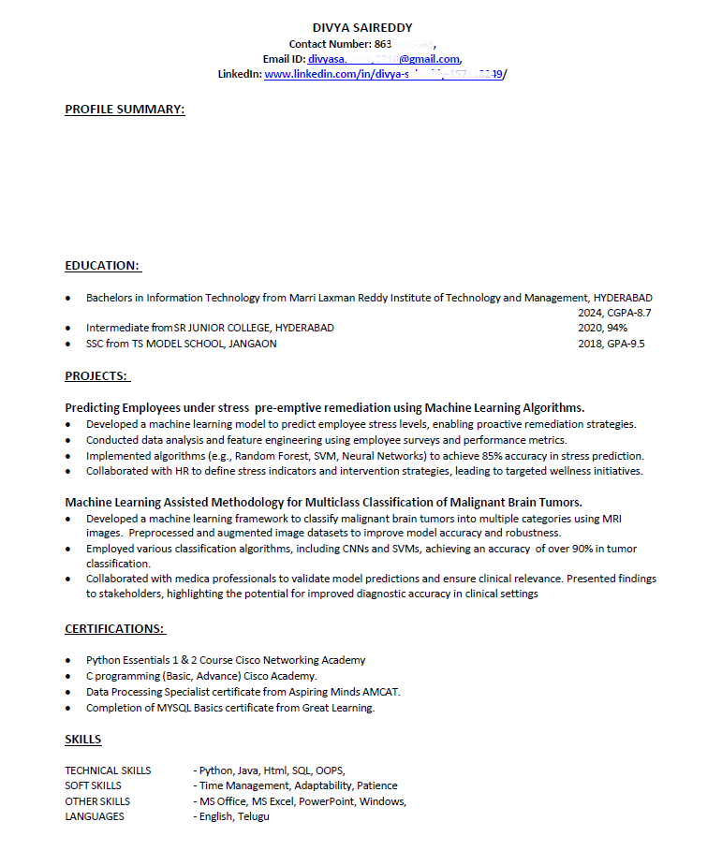
Final Output

Slide 27
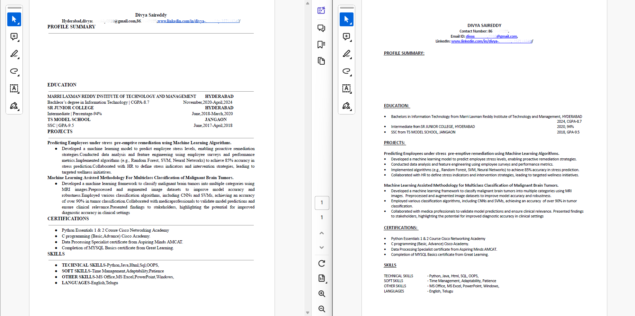
Before
After

